Slide 1

Chapter 11:
Structures
By Tony Gaddis
Slides modified and supplemented by Clare Nguyen

Slide 2
11.2
Combining Data into Structures

Slide 3
Combining Data into Structures
A structure is a C++ construct that allows multiple variables of different data types to be grouped together
General format to declare a structure :
struct Name // Name begins with uppercase letter
{
type1 field1; // fields are listed one per line
type2 field2; // can use comma to separate fields
. . . // if they have the same type
}; // need ; after }
Example of a structure declaration:
struct Student
{
int studentID,
yearInSchool;
string name;
double gpa;
};
structure tag
structure members or fields

Slide 4
Defining Structure Variables
A struct declaration does not take up space in memory
The structure declaration tells the compiler that there is a new data type, and this data type is a user-defined data type
To allocate space for a struct in memory, we need to define a struct variable:
Student george; // note how Student acts like a data type in // the variable definition
The variable definition above allocates space in memory with enough room for each field:
george
studentID
yearInSchool
name
gpa

Slide 5
11.3
Accessing Structure Members

Slide 6
Accessing Structure Members
Use the . (dot) operator to refer to members of struct variables:
cin >> george.studentID; // read in student id for george
getline(cin, george.name); // read in name for george
george.gpa = 3.75; // assign gpa for george
Member variables can be used in any manner appropriate for their data type. For example:
Use arithmetic operators with george.gpa
Use string member function to modify george.name
To print member data, we need to print individual data fields:
cout << george; // not OK
cout << george.studentID; // OK
cout << george.name; // OK
Similarly, to compare 2 structs, we must compare individual fields:
if (george == martha) // not OK
if (george.gpa == martha.gpa) // OK

Slide 7
11.4
Initializing a Structure

Slide 8
Initializing a Structure
A struct variable can be initialized when it is defined:
Student s = {11465, 2, "Martha", 3.75};
Data will be stored in the order that the fields are declared, so make sure there is a match in the sequence of input values and the field declaration order
A structure variable can also be initialized member-by-member after the definition:
s.name = "Martha";
s.gpa = 3.75;
If not all data are known, we can initialize some of the members:
Student george = {14579};
Cannot skip over a data member if the data is unknown
Student s = {1234, , , 2.83}; // Error!
Don’t initialize a structure declaration, since this does not allocate memory and therefore there is no room to store data
If there is no dynamically allocated memory in the structure, an entire structure can be copied:
Student newStu = s; // all fields of s are copied to newStu

Slide 9
11.5
Arrays of Structures

Slide 10
Arrays of Structures
Arrays can have structures as elements
Instead of parallel arrays, we can create an array of structures, where each structure has fields to store the corresponding data of the arrays
Example:
Instead of defining 3 parallel arrays:
string names[MAX_STUDENTS];
double gpa[MAX_STUDENTS];
int studentIDs[MAX_STUDENTS];
We can define:
Student studentList[MAX_STUDENTS];
where each Student element in the array has a name, gpa, ID field
In an array of structures, individual structures can be accessed using index notation: studentList[0] // first student structure in array
Fields within a structure is accessible using dot notation:
cout << studentList[5].studentID;
// print the studentID of the 6th structure in the array

Slide 11
11.6
Nested Structures

Slide 12
Nested Structures
A structure can contain another structure as a member:
struct PersonInfo
{
string name,
address,
city;
};
struct Student
{
int studentID;
PersonInfo pData; // nested struct
short yearInSchool;
double gpa;
};
Use the dot operator in a chain to refer to fields of nested structures:
Student s;
s.pData.name = "George";
s.pData.city = "Mt. Vernon";

Slide 13
11.7
Structures as Function Arguments

Slide 14
Structures as Function Arguments
We can pass members of a struct variable to a function:
computeGPA(aStudent.gpa);
We can use reference parameter if the function needs to modify the fields of the structure
The function computeGPA can change the gpa if the function prototype is:
void computeGPA(double & gpa);
Do not pass an entire structure to a function. This causes the entire structure to be copied into the function, resulting in wasted memory space and slowing down a program
When passing an entire structure to a function, always use pass by reference
If the function is not supposed to change the structure, then pass a const reference parameter:
print(aStudent); // print should not change the // aStudent structure
The prototype of print: void print(const Student & s);

Slide 15
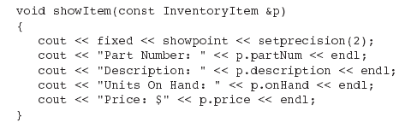
Example of Structure as Input Parameter

Slide 16
11.8
Returning a Structure from a Function

Slide 17
Returning a Structure from a Function
A function can return a struct:
Student getStudentData(); // function prototype
Student stu1 = getStudentData(); // function call
For this to work, the function must define a local structure variable with local data members, and then use the return statement to send the local structure back to the caller
Example:
Function call: Student aStudent = getStudentData();
Function definition:
Student getStudentData()
{
Student tempStu;
cin >> tempStu.studentID;
getline(cin, tempStu.name);
cin >> tempStu.yearInSchool;
cin >> tempStu.gpa;
return tempStu;
}

Slide 18
11.9
Pointers to Structures

Slide 19
Pointers to Structures
A structure variable has an address, and the address can be stored in a pointer variable:
Student * stuPtr = &aStudent;
A structure pointer can be an input parameter to a function
print(stuPtr); // function call
void print(Student * p); // function prototype
Given the pointer to a structure, there are 2 formats to access a field of the structure:
Use () and * and .
cout << (*stuPtr).studentID;
// 1. the () causes dereference of stuPtr with * first,
// 2. then the . accesses the field
Use -> operator
cout << stuPtr->studentID;
// the -> does both: dereferences and accesses a field

Slide 20
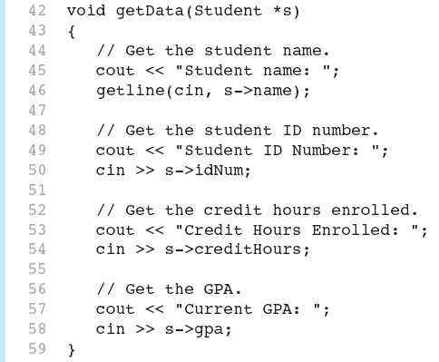
Example of Pointer to struct

Slide 21
11.1
Abstract Data Types

Slide 22
Abstract Data Types
An abstract data type takes the concept of a struct further
An abstract data type (ADT) has 2 parts:
Data part: a structure where data values that can be stored
Operation part: functions that work with the data values
ADTs are created by the programmers, unlike primitive data types such as int, double… that are part of the C++ language
The user of an ADT does not need to know the implementation of the data type, e.g., how the data is stored, what all fields are, etc.
An ADT is an abstraction because it captures the characteristics of a type of data, without going into details
Example: the Student ADT has the characteristics student ID, name, gpa… pertaining to a student, but the user of the Student ADT doesn’t need to know if gpa is a double or float data type
The operations of the Student ADT can be: a getData function that reads student data from the keyboard and stores them in a student struct, an updateGPA function that changes the gpa field of a student struct…
The ADT concept leads us to the idea of classes (which are ADTs) in an object oriented language such as C++

